Slide 1
From raw reads to variants
Malin Larsson
Malin.Larsson@scilifelab.se
Uppsala, January 2020

Slide 2
Talk Overview
Concepts
Reference genome
Alignment
Variants
Paired-end data
Genome Analysis Tool Kit (GATK)
VCF files
Joint genotyping & gVCF files
Best practises
Filtering & Annotation
Notes:
During the course of this talk I hope to explain some core concepts around NGS data such as the basics surrounding what the reference genome, variants and paired-end data is. This will be background information for the main point which is to cover the main concepts of a typical best practice workflow, or as some people call it a “pipeline”, where we take the raw reads in fastq format all the way to variants. I will dive a little deeper into the output from variant calling, the VCFs or Variant Call Format, what joint genotyping is and the principal of annotating and filtering the variants.
As with anything there is more to know about each of these subjects and I encourage you to go deeper as needed.

Slide 3

Reference genome
Genome Reference Consortium
A mosaic nucleic acid sequence
...GTGCGTAGACTGCTAGATCGAAGA...
What changes between versions?
First version: 150,000 gaps
HG19: 250 gaps
Notes:
The first concept we need to understand is what the reference genome is. It is a haploid nucleic acid sequence which represents a species.
HG19 was release in 2009 and is based on thirteen anonymous volunteers from Buffalo, NY.
Roughly; the newer the version of the reference genome the fewer the gaps. Compare the first version of the human genome which had 150k gaps and hg19 which had 250. The latest human reference genome, HG38, was release 24th of December 2013. So what it all boils down to is that this is a genetic map of a species.

Slide 4
Variants
A position where sample sequence does not agree with reference genome sequence
Reference: ...GTGCGTAGACTGCTAGATCGAAGA...
Sample: ...GTGCGTAGACTGATAGATCGAAGA...
Notes:
Keeping that in mind, what is a variant? A variant is a position where the samples sequence does not agree with the reference genome sequence. Here for example is 24 nucleotides from a reference genome.
When I then align the genomic sequence of a sample to the reference genome and compare we see that in one position where the reference sample is Cytosine we have Adenine. In this case this is a variant in that sample.

Slide 5

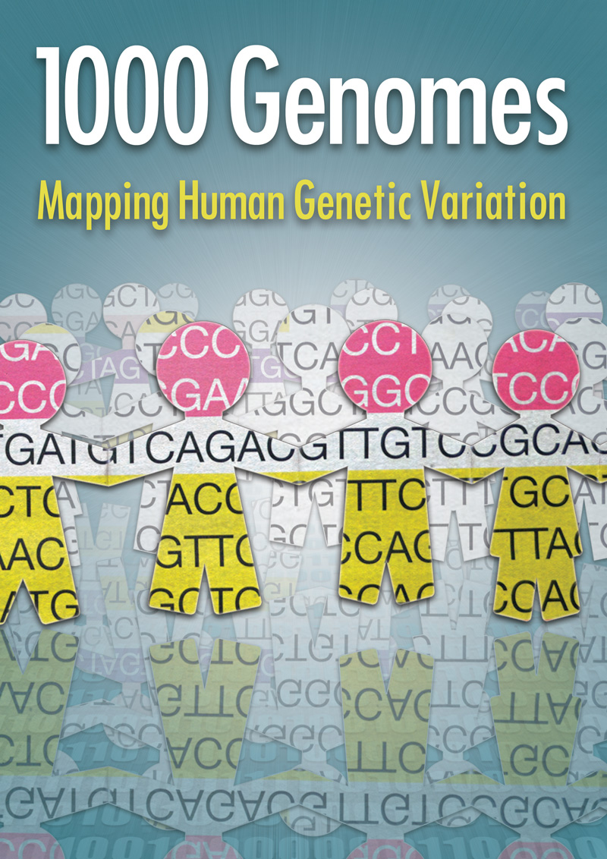

Variants
Population based variant projects
Notes:
Looking at the bigger picture of variants for multiple samples, such as whole populations we have population based variation projects such as the UK 10K and 1000Genomes project that map the variation of many humans giving the frequency of variants so that we can know if they are common or rare in a population.
The genetics of these samples coupled with the phenotypic traits of the donors make them a good resource for, for example, genome wide association studies.
If a single nucleotide variant, or polymorphism, exists to an appreciable degree in a population, eg > 1%, we usually refer to it as a SNP.

Slide 6
Illumina sequencing
https://www.youtube.com/watch?v=fCd6B5HRaZ8

Slide 7
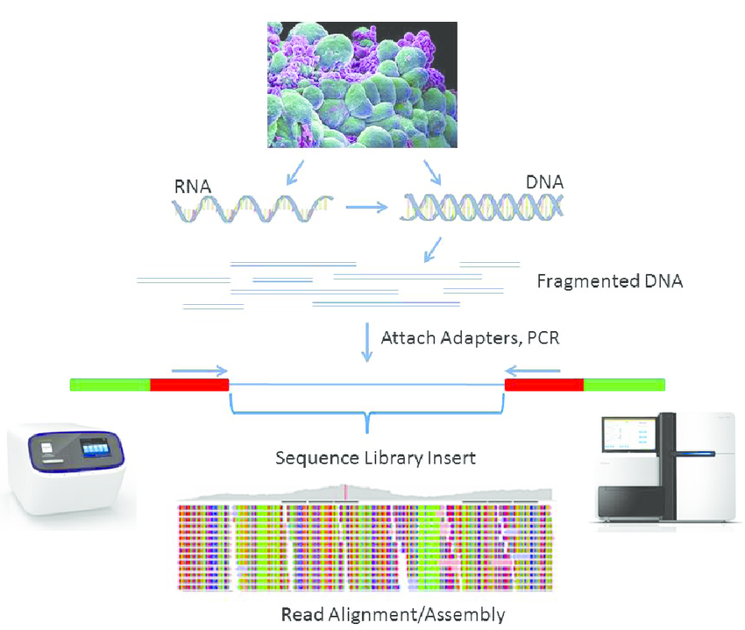
NGS overview
Library construction for next-generation sequencing: Overviews and challenges, Steven Head et al.
Notes:
The final important concept before we move on to the NGS workflow.
To describe our input data we need a brief refresher on what our data actually is. Paired end sequencing starts off similarly to other sequence protocols where the DNA is fragmented and adaptors are ligated to the ends of a fragment and are PCR amplified to generate clusters. The adaptors find complementary locations on a flowcell.
After this the reverse strands are washed off and the forward strands are sequenced. Then the clusters are regenerated and the reverse strands are sequenced.
DNA Fragmentation
Adaptors attached
PCR amplification – not always
Attach to flowcell
Reverse flushed, forward sequenced
Clusters regenerated, forward flushed and reverse sequenced.

Slide 8
Paired-end data
Notes:
Here is a more clear picture of just a paired end read. We have the adapters flanking the fragment. The fragment length is the entire fragment, adapters and all, whereas the insert size contains the reads themselves and the distance between them. Since we knew the length of the insert this means that we can expect the inner distance between the pairs, something very convenient that we will get back to later.

Slide 9
Paired-end data
The forward and reverse reads are stored in two fastq files.
The order of pairs and naming is identical, except the designation of forward and reverse.
ID_R1_001.fastq
ID_R2_001.fastq
@HISEQ:100:C3MG8ACXX:5:1101:1160:2197 1:N:0:ATCACG
CAGTTGCGATGAGAGCGTTGAGAAGTATAATAGGAGTTAAACTGAGTAACAGGATAAGAAATAGTGAGATATGGAAACGTTGTGGTCTGAAAGAAGATGT
+
B@CFFFFFHHHHHGJJJJJJJJJJJFHHIIIIJJJIHGIIJJJJIJIJIJJJJIIJJJJJIIEIHHIJHGHHHHHDFFFEDDDDDCDDDCDDDDDDDCDC
@HISEQ:100:C3MG8ACXX:5:1101:1160:2197 2:N:0:ATCACG
CTTCGTCCACTTTCATTATTCCTTTCATACATGCTCTCCGGTTTAGGGTACTCTTGACCTGGCCTTTTTTCAAGACGTCCCTGACTTGATCTTGAAACG
+
CCCFFFFFHHHHHJJJJIJJJJJJJJJJJJJJJJJJJJJJIJIJGIJHBGHHIIIJIJJJJJJJJIJJJHFFFFFFDDDDDDDDDDDDDDDEDCCDDDD
Notes:
Now the data has been delivered from the sequencing facility, we have two files containing the forward and reverse reads. These are stored in two fastq files. The two reads have identical metadata except for the information of which is the forward and reverse read.
The R1 tag and the 1 here which signify that this file contains all the forward reads. Similarly the R2 file contains all the reverse read pairs.

Slide 10
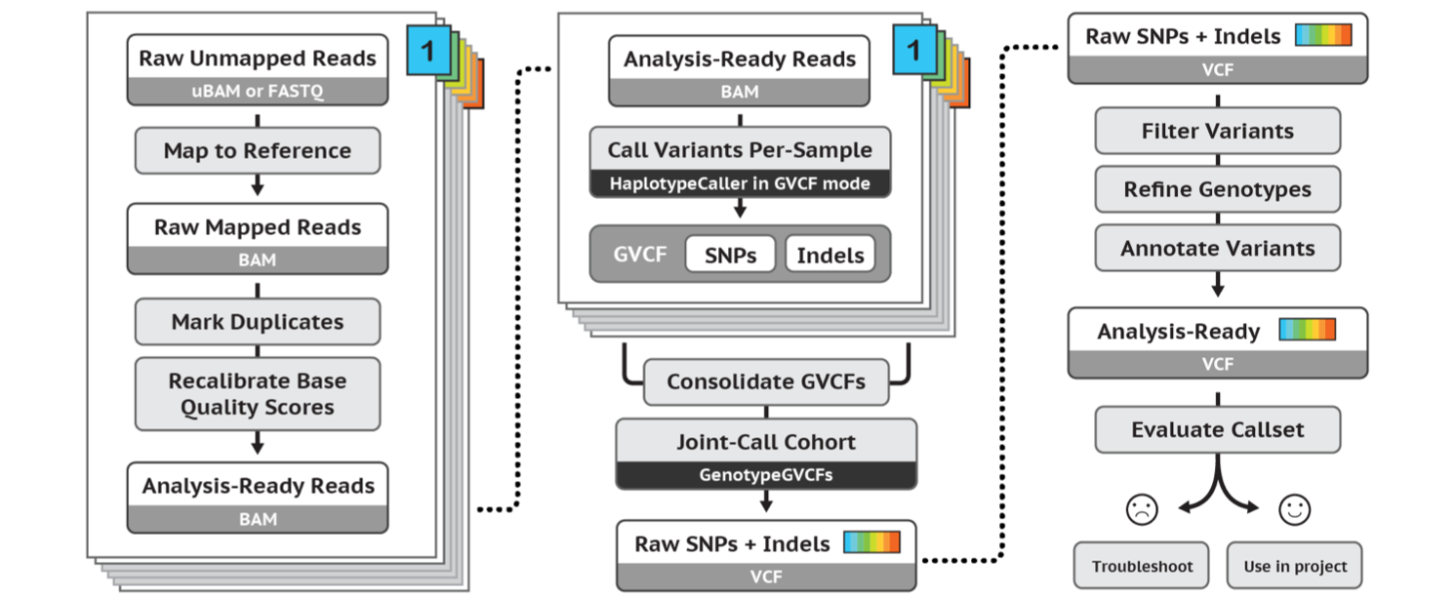
GATK Best Practice Variant Calling Workflow
https://software.broadinstitute.org/gatk/best-practices/
Germline short variant discovery (SNPs + Indels)
Notes:
But before we dive in to alignment I will mention that this is where the recommendations of the Broad institute best practices start. A guide that they have maintained pretty-well for several years where they recommend tools and setting to use for a standard analysis. I recommend that someone setting up a bioinformatics workflow or wanting to compare what has been done with their data and what is currently considered best practice be intimately aware of these recommendations.
//A recent change has been made where they no longer recommend indel realignment, as it is performed on the fly at the variant calling stage. It is good to note that this resource exists, as it is definitely something you should be looking at when running a variant calling pipeline as it is needed in some cases.

Slide 11
Todays workshop part one: Basic variant calling workflow for one sample

Slide 12
Basic variant calling workflow
Only for learning the concepts!
The minimum steps to go from fastq files to vcf file for one sample.
First part of todays practical workshop.
Notes:
We will focus on the absolutely minimal number of steps we can use to go from fastq files to a vcf file for one sample.

Slide 13
Basic variant calling workflow
Variant calling
Alignment
QC
FASTQ files
BAM files
VCF files

Slide 14
Basic variant calling workflow
Variant calling
Alignment
QC

Slide 15
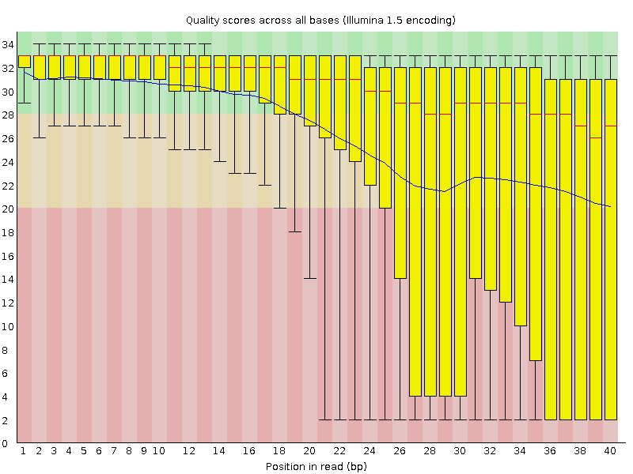
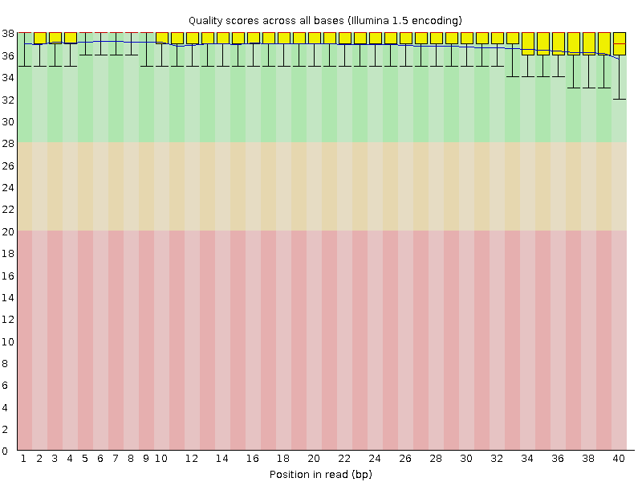
Quality control
module load FastQC
Bad qualities: Good qualities:
Notes:
One commonly used tool for quality control is FastQC which you can load using Uppmaxs module load system as shown here. If you have multiple samples a good tool developed out of NGI stockholm is MultiQC which concatenates and visualizes the qualities of multiple samples.
But first, lets just talk abit about some of the usual suspects when quality controlling the data.
(The qualities should have been discussed earlier during Martins lectures)
Here we see two examples of the individual base qualities across the read length. A usual cutoff for quality score is around 20, today with improving techniques you will find people set it even higher, at around 30. It is a balancing act of how much data you can afford to throw away based on quality and how low quality you dare keep since it may give errors later on.
Q20 means about 99% chance that the base in that position is correct.
Q=-10*log10(P)
P=Base call accuracy

Slide 16
Basic variant calling workflow
Variant calling
Alignment
QC

Slide 17
Alignment
module load bwa
Read TCGATCC
Reference GACCTCATCGATCCCACTG
Notes:
Alignment.
The most commonly used aligner for NGS data at the moment is BWA, or the Burrows-Wheeler Aligner, where Burrows Wheeler transform is used for patternmatching.
What we are trying to do in its simplest form is take one of our reads and fit it to its position on the reference genome. So here we have a read from our sample and the reference genome.

Slide 18
Alignment
module load bwa
Read TCGATCC
Reference GACCTCATCGATCCCACTG
Read TCGATCC
Reference GACCTCATCGATCCCACTG
Notes:
And here we have found the position where it matches the reference. And then do this for every read.

Slide 19
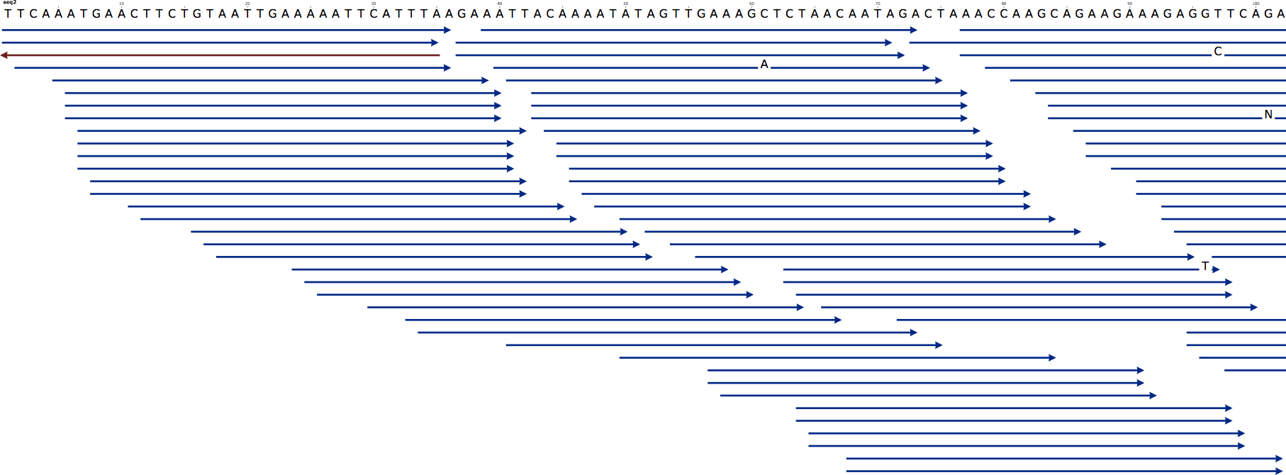
Alignment
module load bwa
Notes:
But of course we didn’t have just one read. Here we have a picture with the reference genome at the top and a collection of reads aligned to it. If you have heard of the “coverage” of your sample before this is what is meant.

Slide 20
Alignment
module load bwa
Coverage
Notes:
But of course we didn’t have just one read. Here we have a picture with the reference genome at the top and a collection of reads aligned to it. If you have heard of the “coverage” of your sample before this is what is meant.
The coverage is the number of reads aligned to a position. The average coverage of the sample then is the average number of reads covering a position over each genomic position. For example….

Slide 21
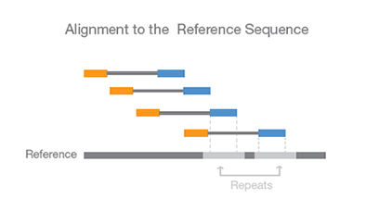
Paired-end data & Alignment
The known distance between paired reads allows improved mapping over repeat regions
Notes:
A brief interlude; Remember how I spoke earlier about paired end data? Now that you know what alignment is I can explain that one of the strengths of paired end data is that since the distance between the paired reads is known we can infer the position of the other read in repeat regions. After all once one read has mapped we know the approximate position of its pair.
Here is an illustration of this where we have two repeat regions and the blue read could easily map to either one but we know which one it maps to because of the position of its orange pair.
This property is also helpful for finding SVs.

Slide 22
Output from mapping - Sam format
HEADER SECTION
@HD VN:1.0 SO:coordinate
@SQ SN:1 LN:249250621 AS:NCBI37 UR:file:/data/local/ref/GATK/human_g1k_v37.fasta M5:1b22b98cdeb4a9304cb5d48026a85128
@SQ SN:2 LN:243199373 AS:NCBI37 UR:file:/data/local/ref/GATK/human_g1k_v37.fasta M5:a0d9851da00400dec1098a9255ac712e
@SQ SN:3 LN:198022430 AS:NCBI37 UR:file:/data/local/ref/GATK/human_g1k_v37.fasta M5:fdfd811849cc2fadebc929bb925902e5
@RG ID:UM0098:1 PL:ILLUMINA PU:HWUSI-EAS1707-615LHAAXX-L001 LB:80 DT:2010-05-05T20:00:00-0400 SM:SD37743 CN:UMCORE
@RG ID:UM0098:2 PL:ILLUMINA PU:HWUSI-EAS1707-615LHAAXX-L002 LB:80 DT:2010-05-05T20:00:00-0400 SM:SD37743 CN:UMCORE
@PG ID:bwa VN:0.5.4
ALIGNMENT SECTION
8_96_444_1622 73 scaffold00005 155754 255 54M * 0 0 ATGTAAAGTATTTCCATGGTACACAGCTTGGTCGTAATGTGATTGCTGAGCCAG C@B5)5CBBCCBCCCBC@@7C>CBCCBCCC;57)8(@B@B>ABBCBC7BCC=> NM:i:0
8_80_1315_464 81 scaffold00005 155760 255 54M = 154948 0 AGTACCTCCCTGGTACACAGCTTGGTAAAAATGTGATTGCTGAGCCAGACCTTC B?@?BA=>@>>7;ABA?BB@BAA;@BBBBBBAABABBBCABAB?BABA?BBBAB NM:i:0
8_17_1222_1577 73 scaffold00005 155783 255 40M1116N10M * 0 0 GGTAAAAATGTGATTGCTGAGCCAGACCTTCATCATGCAGTGAGAGACGC BB@BA??>CCBA2AAABBBBBBB8A3@BABA;@A:>B=,;@B=A:BAAAA NM:i:0 XS:A:+ NS:i:0
8_43_1211_347 73 scaffold00005 155800 255 23M1116N27M * 0 0 TGAGCCAGACCTTCATCATGCAGTGAGAGACGCAAACATGCTGGTATTTG #>8<=<@6/:@9';@7A@@BAAA@BABBBABBB@=<A@BBBBBBBBCCBB NM:i:2 XS:A:+ NS:i:0
8_32_1091_284 161 scaffold00005 156946 255 54M = 157071 0 CGCAAACATGCTGGTAGCTGTGACACCACATCAACAGCTTGACTATGTTTGTAA BBBBB@AABACBCA8BBBBBABBBB@BBBBBBA@BBBBBBBBBA@:B@AA@=@@ NM:i:0
Start position
Quality
Sequence
Read name
Notes:
QNAME: the name of the read.
FLAG: a bitwise number describing information about the read such as mapped/unmapped read, pairing, etc.
RNAME: the reference sequence name. The value of this field is * for unmapped reads.
POS: the left most mapping position of the first matching base. It is set to zero for unmapped reads.
MAPQ: a number to indicate the mapping quality.
CIGAR: a string describing how the read aligns with the reference. It consists of one or more components. Each component comprises an operator and the number of bases which the operator applies to. Operators are: MIDNSHP=X. The following table gives an overview of these operators
MNAME: the name of the mate strand, if it is a paired read. ‘=’ means that the name is the same as RNAME.
MPOS: a number indicating the left most mapping position of the mate.
TLEN: a number set to 0 for single-segment. For paired-segments it is calculated as the number of bases from the left most mapped base to the right most mapped base.
SEQ: the read sequence as the reference. If not ‘*’ then the length of the sequence must be equal the sum of lengths of M/I/S/=/X operations in the CIGAR string.
QUAL: the read quality, same as the quality string in a fastaq format.

Slide 23
Read groups
Link information of sample id, library prep, flowcell and sequencing runs to fastq file.
Good for error tracking!
Detailed description in tutorial or https://gatkforums.broadinstitute.org/gatk/discussion/6472/read-groups
RGID = Read group identifier usually derived from the combination of the sample id and run id
RGLB = Library prep identifier
RGPL = Platform (for us ILLUMINA)
RGPU = Run identifier usually barcode of flowcell
RGSM = Sample name

Slide 24
Convert to Bam
Bam file is a binary representation of the Sam file

Slide 25
Basic variant calling workflow
Variant calling
Alignment
QC

Slide 26
Variant calling
Reference: ...GTGCGTAGACTGCTAGATCGAAGA...
Sample: ...GTGCGTAGACTGATAGATCGAAGA...
...GTGCGTAGACTGATAGATCGAAGA...
...GTGCGTAGACTGCTAGATCGAAGA...
...GTGCGTAGACTGCTAGATCGAAGA...
...GTGCGTAGACTGATAGATCGAAGA...
...GTGCGTAGACTGATAGATCGAAGA...
...GTGCGTAGACTGCTAGATCGAAGA...
...GTGCGTAGACTGATAGATCGAAGA...
...GTGCGTAGACTGCTAGATCGAAGA...
...GTGCGTAGACTGATAGATCGAAGA...
$$\frac{\#alternative allels in a position}{\#Reads in a position }=alternative allele frequency$$
Notes:
Variant calling is looking for positions where some number of reads disagree with the reference genome. Here for example the reference sample says the position should be a C whereas 6 of the reads say it is an A in the sample. This is also what is meant with the allelic frequency of a variant, out of 10 reads 6 are variant therefore the allelic frequency of A is 60%.
Note that this is not the same as population based allele frequencies that measures the relative frequency of an allele in a population.

Slide 27
Variant Calling HaplotypeCaller
Notes:
Define active regions. Identify regions of the genomes in which the samples being analyzed show substantial evidence of variation relative to the reference.
Determine haplotypes by local assembly of the active region.The goal of this step is to reconstruct the possible sequences of the real physical segments of DNA present in the original sample..
The most likely haplotypes, supported by many reads, are reported. All haplotypes are then aligned against the reference genome, and variant sites are reported.
3. Determine likelihoods of the haplotypes given the read data. For each ActiveRegion, the program performs a pairwise alignment of each read against each haplotype using the PairHMM algorithm. The algorithm takes into account the information the quality of the data (i.e. the base quality scores and indel quality scores). This produces a matrix of likelihoods of haplotypes given the read data.
These likelihoods are then marginalized to obtain the likelihoods of alleles per read for each potentially variant site.
4. Assign sample genotypes. Calculates the posterior likelihoods of each genotype per sample given the read data observed for that sample. For each variant, the most likely genotype is then assigned to the sample.

Slide 28
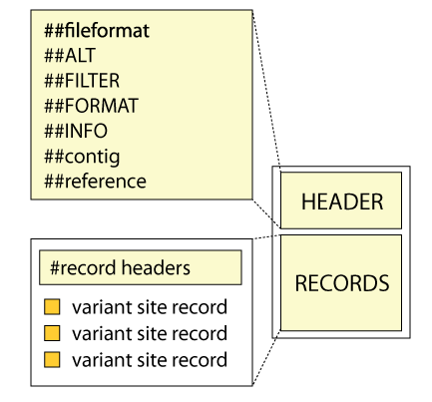
Variant Call Format (VCF)

Slide 29
Variant Call Format (VCF)
##fileformat=VCFv4.3
##fileDate=20090805
##source=myImputationProgramV3.1
##reference=file:///seq/references/1000GenomesPilot-NCBI36.fasta
##contig=<ID=20,length=62435964,assembly=B36,md5=f126cdf8a6e0c7f379d618ff66beb2da,species="Homo sapiens”... ##phasing=partial
##INFO=<ID=NS,Number=1,Type=Integer,Description="Number of Samples With Data">
##INFO=<ID=DP,Number=1,Type=Integer,Description="Total Depth">
##INFO=<ID=AF,Number=A,Type=Float,Description="Allele Frequency">
##INFO=<ID=AA,Number=1,Type=String,Description="Ancestral Allele">
##INFO=<ID=DB,Number=0,Type=Flag,Description="dbSNP membership, build 129">
##INFO=<ID=H2,Number=0,Type=Flag,Description="HapMap2 membership">
##FILTER=<ID=q10,Description="Quality below 10">
##FILTER=<ID=s50,Description="Less than 50% of samples have data">
##FORMAT=<ID=GT,Number=1,Type=String,Description="Genotype">
##FORMAT=<ID=GQ,Number=1,Type=Integer,Description="Genotype Quality">
##FORMAT=<ID=DP,Number=1,Type=Integer,Description="Read Depth">
#CHROM POS ID REF ALT QUAL FILTER INFO FORMAT NA00001 NA00002 NA00003
14370 rs6054257 G A 29 PASS NS=3;DP=14;AF=0.5;DB;H2 GT:GQ:DP 0|0:48:1 1|0:48:8 1|1:43:5
20 17330 . T A 3 q10 NS=3;DP=11;AF=0.017 GT:GQ:DP 0|0:49:3 0|1:3:5 0|0:41:3
20 1230237 . T . 47 PASS NS=3;DP=13;AA=T GT:GQ:DP 0|0:54:7 0|0:48:4 0|0:61:2
20 1234567 microsat1 GTC G,GTCT 50 PASS NS=3;DP=9;AA=G GT:GQ:DP 0|1:35:4 0|2:17:2 1|1:40:3
Notes:
VCF files, or variant call format files, are divided into two main parts. The top, or head, of the file, with hashtag prefixed lines, is a descriptive part explaining the information given for each variant and each sample, if multiple samples exists. It also gives the date and some information from the variant caller used.
Below this are the actual variants, one line per variant.
Now lets look at each part alittle closer.
(Update later to latest vcf format)

Slide 30
Indices
Most large files we work with need an index
Different index for different file-types
Bwa index creates one set of index for the reference that it needs for performing alignment
Other programs like samtools produce other types of index for .fasta and .bam files needed by other programs

Slide 31
Workflow conventions
create a new output file in each process
Use informative file names
Notes:
In order to keep track of all the processes you will run during the exercise it is important to organize your data.
Use good file names. For example “sample.fastq”.
In each analysis step you define an input file and an output file. ALWAYS create a new output file, i.e. do not overwrite the input file.
It is a good practice to include the name of the analysis step (or shortened namethe output file name.

Slide 32
Example
Sample.sam
Convert to bam
Sample.bam
Sample_1.fastq
Sample_2.fastq
Alignment
MarkDuplicates
Sample.dedup.bam
…

Slide 33
Todays exercise
Notes:
Thank you and questions?
The exercises, can be reached as usual through the schedule for the course.

Slide 34
1000 Genomes data
Variant calling workflow in 3 samples
Low coverage WGS data
Fastq files to annotated vcf
Small region on chromosome 2
About the samples:
https://www.internationalgenome.org/data-portal/sample

Slide 35
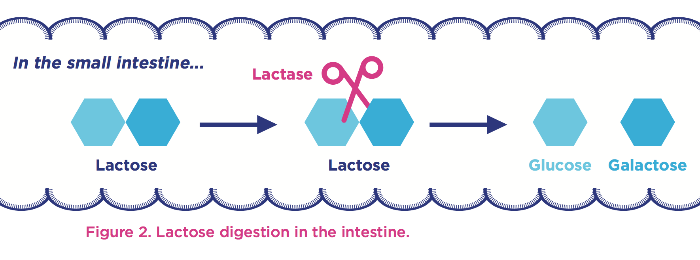
Lactose and Lactase
http://www.yogurtinnutrition.com/lactose-as-a-nutrient/
Notes:
Most people are born with the ability to digest lactose, the major carbohydrate in milk and the main source of nutrition until weaning.
Lactase is an enzyme expressed in the small intestine.
Cuts the lactose molecule into one glucose and one galactose molecule.
Lactase is encoded by the LCT gene, located on chromosome 2.

Slide 36
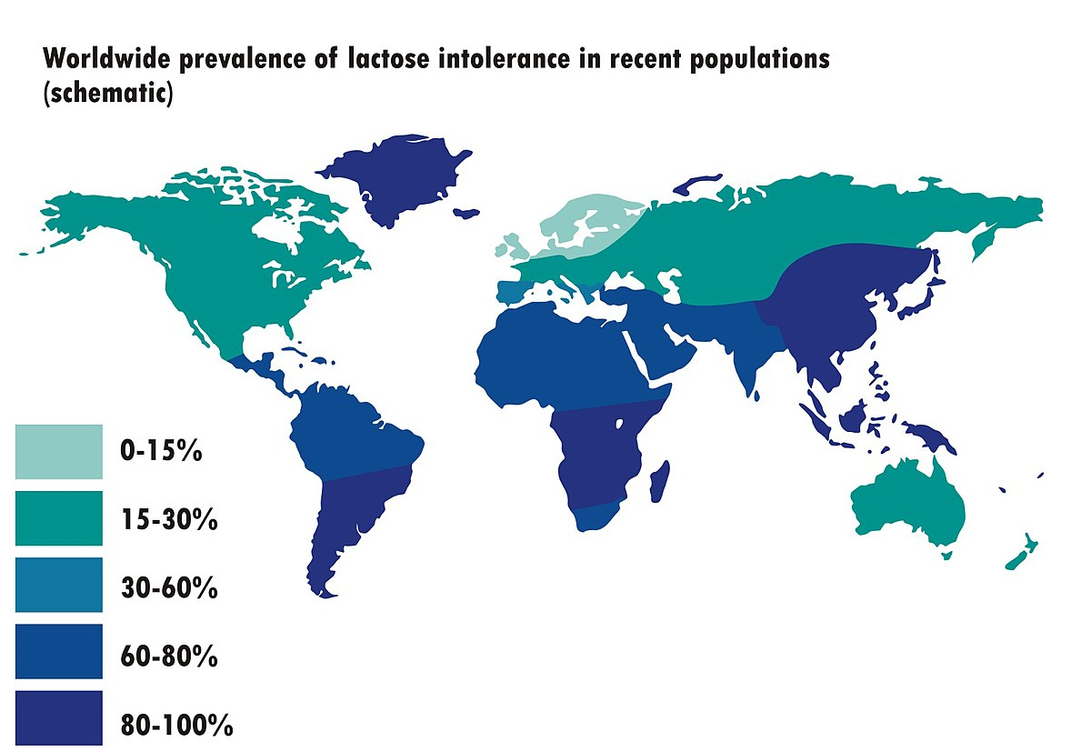
Prevalence of lactose intolerance
Notes:
Most people are born with the ability to digest lactose, the major carbohydrate in milk and the main source of nutrition until weaning.
Approximately 75% of the world’s population loses the ability to digest lactose at some point, while others can digest lactose into adulthood.
Genetic variants in or near the LCT (lactase) gene affects if a person can digest lactase in adulthood.

Slide 37
Todays workshop part two: Joint variant calling of cohorts

Slide 38
Joint genotyping of cohort

Slide 39
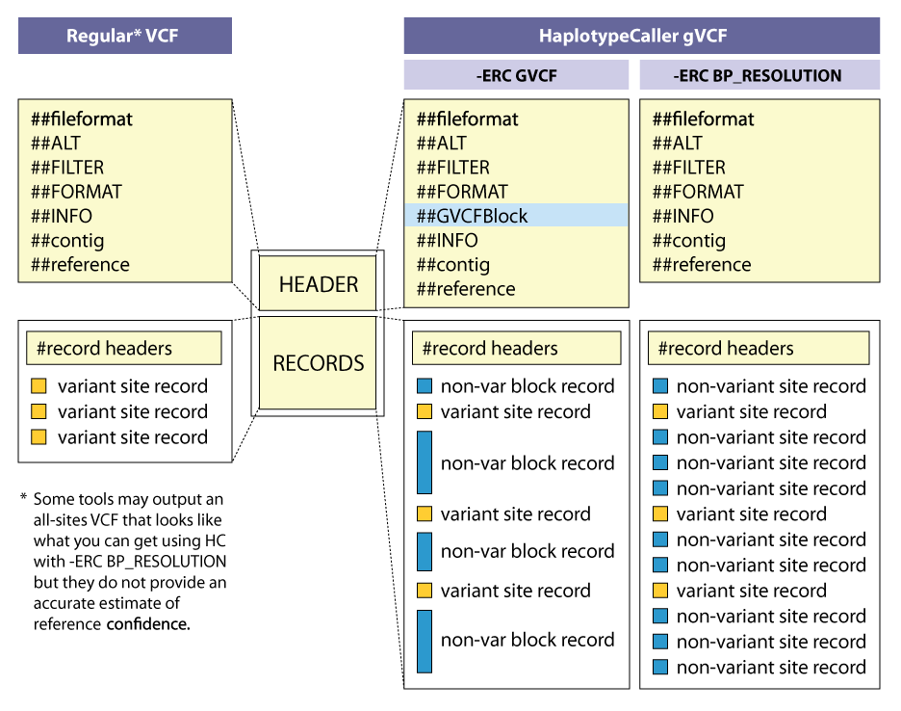
gVCF Files
Notes:
For joint genotyping projects we use a different kind of VCF file.
A gVCF file has the same format as a VCF file but it has information for all sites, not just variants. There are two kinds of gVCF files, the older ones had individual records for each site but this is space inefficient.
The new ones have individual variant records for variant sites, but the non-variant sites are grouped together into non-variant block records that represent intervals of sites for which the genotype quality (GQ) is within a certain range or band.
http://gatkforums.broadinstitute.org/wdl/discussion/4017/what-is-a-gvcf-and-how-is-it-different-from-a-regular-vcf
In the so-called GVCF mode used for scalable variant calling in DNA sequence data, HaplotypeCaller runs per-sample to generate an intermediate genomic gVCF (gVCF), which can then be used for joint genotyping of multiple samples in a very efficient way, which enables rapid incremental processing of samples as they roll off the sequencer, as well as scaling to very large cohort sizes (e.g. the 92K exomes of ExAC).

Slide 40
Joint genotyping of cohort
Module load GATK
For each sample in cohort:
java -Xmx7g -jar $GATK_HOME/GenomeAnalysisTK.jar
-T HaplotypeCaller
-R Human_genome.fasta
-I sample.bam
-o sample.g.vcf
--emitRefConfidence GVCF
For the entire ccohort:
java -Xmx7g -jar $GATK_HOME/GenomeAnalysisTK.jar
-T GenotypeGVCFs
-R Human_genome.fasta
--variant sample1.g.vcf
--variant sample2.g.vcf
--variant sample3>g.vcf
-o cohort.vcf

Slide 41
Joint variant calling workflow
HaplotypeCaller
--emitRefConfidence GVCF
Sample1.g.vcf
Sample1_1.fastq
Sample1_2.fastq
Alignment
HaplotypeCaller
--emitRefConfidence GVCF
Sample3.g.vcf
Sample2_1.fastq
Sample2_2.fastq
Alignment
HaplotypeCaller
--emitRefConfidence GVCF
Sample3.g.vcf
Sample3_1.fastq
Sample3_2.fastq
Alignment
Cohort.vcf
GenotypeGVCFs

Slide 42
Todays workshop part three: Following GATK best practices

Slide 43
GATK Best Practice Variant Calling Workflow
https://software.broadinstitute.org/gatk/best-practices/
Germline short variant discovery (SNPs + Indels)
Notes:
But before we dive in to alignment I will mention that this is where the recommendations of the Broad institute best practices start. A guide that they have maintained pretty-well for several years where they recommend tools and setting to use for a standard analysis. I recommend that someone setting up a bioinformatics workflow or wanting to compare what has been done with their data and what is currently considered best practice be intimately aware of these recommendations.
//A recent change has been made where they no longer recommend indel realignment, as it is performed on the fly at the variant calling stage. It is good to note that this resource exists, as it is definitely something you should be looking at when running a variant calling pipeline as it is needed in some cases.

Slide 44
Mark Duplicates
Notes:
But before we dive in to alignment I will mention that this is where the recommendations of the Broad institute best practices start. A guide that they have maintained pretty-well for several years where they recommend tools and setting to use for a standard analysis. I recommend that someone setting up a bioinformatics workflow or wanting to compare what has been done with their data and what is currently considered best practice be intimately aware of these recommendations.
//A recent change has been made where they no longer recommend indel realignment, as it is performed on the fly at the variant calling stage. It is good to note that this resource exists, as it is definitely something you should be looking at when running a variant calling pipeline as it is needed in some cases.

Slide 45
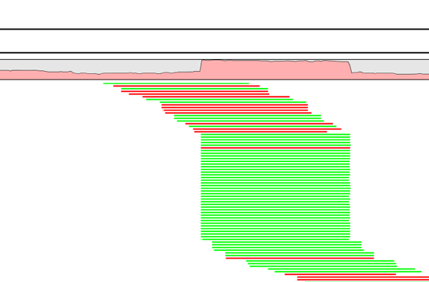
Duplicate reads
PCR duplicates - library preparation
Optical duplicates - sequencing
Don’t add unique information
Gives false allelic ratios of variants
Should be removed/marked
Notes:
One tool for this is picards MarkDuplicates.
Occur PCR
Copies same fragment goto different flowcells
High library complexity is good
Don’t add information
Optical duplicates
Less talked about
One flowcell cluster
Incorrectly identified on several cells
Amplicon
Duplicates typically arise during PCR amplification of the fragments with adapters. We are intentionally creating multiple copies of each original genomic DNA molecule so that you have enough of them. The PCR duplicates occur when two copies of the same original molecule get onto different areas of the flowcell. A greater amount of starting material, often termed as having a high complexity library, is a good indicator of not having a big problem with duplicates.
And duplicates don’t give any additional information, as you can see here, what we want is reads slightly off from eachother, so we know that they are adding new information. You can also choose to just mark the duplicates rather than remove them entirely as many variant callers can ignore reads marked as duplicates. This gives you the option later to perform variant calling with and without duplicates and compare the results.
Finally, during some kinds of sequencing, such as amplicon sequencing, you tend to recommend not removing duplicates as there will be many duplicates by design. So keep that in mind.
“optical duplicates are sequences from one flow cell cluster, that are (incorrectly) identified by software to be from multiple adjacent clusters. ”

Slide 46
Picard MarkDuplicates
Module load Picard
java -Xmx7g -jar $PICARD_HOME/picard.jar MarkDuplicates
INPUT=sample.bam
OUTPUT=sample.md.bam
METRICS_FILE=sample.md.metrix.txt
READ_NAME_REGEX=null

Slide 47
Base Quality Score Recalibration (BQSR)
Notes:
But before we dive in to alignment I will mention that this is where the recommendations of the Broad institute best practices start. A guide that they have maintained pretty-well for several years where they recommend tools and setting to use for a standard analysis. I recommend that someone setting up a bioinformatics workflow or wanting to compare what has been done with their data and what is currently considered best practice be intimately aware of these recommendations.
//A recent change has been made where they no longer recommend indel realignment, as it is performed on the fly at the variant calling stage. It is good to note that this resource exists, as it is definitely something you should be looking at when running a variant calling pipeline as it is needed in some cases.

Slide 48
Base Quality Score Recalibration (BQSR)
During base calling, the sequencer estimates a quality score for each base. This is the quality scores present in the fastq files.
Systematic (non-random) errors in the base quality score estimation can occur.
due to the physics or chemistry of the sequencing reaction
manufacturing flaws in the equipment
etc
Can cause bias in variant calling
Base Qualtiy Score Recalibration helps to calibrate the scores so that they correspond to the real per-base sequencing error rate (phred scores)
Notes:
Base Quality Score Recalibration basically detects systematic errors made by the sequencer when it estimates the quality score of each base call, which is basically how confident the machine was that the called base is correct.
Some of these errors are due to the physics or the chemistry of how the sequencing reaction works, and some can be due to manufacturing flaws in the equipment.
The tool checks the covariation between Reported quality score, the position within the read and the preceding and current nucleotide observed by the sequencing machine to find non-random discrepancies that lead to the score being adjusted.
These systematic technical errors, leading to over- or under-estimated base quality scores in the data.

Slide 49
Base Quality Score Recalibration (BQSR)
Module load GATK
java -Xmx7g -jar $GATK_HOME/GenomeAnalysisTK.jar
-T BaseRecalibrator
-R Human_genome.fasta
-I sample.bam
-o sample_calibrationtable.txt
-knownSites high_confidence_SNPs.vcf
java -Xmx7g -jar $GATK_HOME/GenomeAnalysisTK.jar
-T PrintReads
-R Human_genome.fasta
-BQSR sample_calibrationtable.txt
-I sample.bam
-o sample.bsqr.bam
Generates a recalibration table
Applies the recalibration table on the bam file.
Generates new recalibrated bam.

Slide 50
Filter variants
https://software.broadinstitute.org/gatk/best-practices/
Germline short variant discovery (SNPs + Indels)
Notes:
But before we dive in to alignment I will mention that this is where the recommendations of the Broad institute best practices start. A guide that they have maintained pretty-well for several years where they recommend tools and setting to use for a standard analysis. I recommend that someone setting up a bioinformatics workflow or wanting to compare what has been done with their data and what is currently considered best practice be intimately aware of these recommendations.
//A recent change has been made where they no longer recommend indel realignment, as it is performed on the fly at the variant calling stage. It is good to note that this resource exists, as it is definitely something you should be looking at when running a variant calling pipeline as it is needed in some cases.

Slide 51
Filtering
Remove low quality variants
Variant quality score recalibration (VQSR):
For large data sets ( >1 WGS or >30WES samples)
GATK has a machine learning algorithm that can be trained to recognise ”likely false” variants
We do recommend to use VQSR when possible!
Hard filters:
For smaller data sets
Hard filters on information in the VCF file
For example: Flag variants with ”QD < 2” and ”MQ< 40.0”
GATK recommendations on hard filters: https://gatkforums.broadinstitute.org/gatk/discussion/2806/howto-apply-hard-filters-to-a-call-set
Notes:
A typical scenario requiring manual filtration is small cohort callsets, e.g. less than thirty exomes.

Slide 52
Filtering SNPs
module load GATK
java -Xmx7g -jar $GATK_HOME/GenomeAnalysisTK.jar
-T SelectVariants
-R Human_genome.fasta
-V cohort.vcf
-selectType SNP
-o snps.vcf
java -Xmx7g –jar $GATK_HOME/GenomeAnalysisTK.jar
-T VariantFiltration
-R Human_genome.fasta
-V snps.vcf
-o snps.filtered.vcf
--filterExpression "QD < 2.0"
--filterName QDfilter
--filterExpression "MQ < 40.0"
--filterName MQfilter
--filterExpression "FS > 60.0"
--filterName FSfilter
Notes:
QUAL tells you how confident we are that there is some kind of variation at a given site. The variation may be present in one or more samples.
The QD is the QUAL score normalized by allele depth (AD) for a variant. For a single sample, the HaplotypeCaller calculates the QD by taking QUAL/AD.
In case of multisample vcf, QD is calculated by QUAL/(sum of non hom-ref DP) i.e. sum of depth for samples that are not homozygous for reference allele.
MQ = Root mean square of the mapping quality of reads across al l samples (MQ).
The value output for this annotation is the u-based z-approximation from the Mann-Whitney-Wilcoxon Rank Sum Test for mapping qualities (MAPQ of reads supporting REF vs. MAPQ of reads supporting ALT).

Slide 53
Filtering INDELs
module load GATK
java -Xmx7g -jar $GATK_HOME/GenomeAnalysisTK.jar
-T SelectVariants
-R Human_genome.fasta
-V cohort.vcf
-selectType INDEL
-o indels.vcf
java -Xmx7g –jar $GATK_HOME/GenomeAnalysisTK.jar
-T VariantFiltration
-R Human_genome.fasta
-V indels.vcf
-o indels.filtered.vcf
--filterExpression "QD < 2.0"
--filterName QDfilter
--filterExpression "FS > 200.0"
--filterName FSfilter
Notes:
QUAL tells you how confident we are that there is some kind of variation at a given site. The variation may be present in one or more samples.
The QD is the QUAL score normalized by allele depth (AD) for a variant. For a single sample, the HaplotypeCaller calculates the QD by taking QUAL/AD.
In case of multisample vcf, QD is calculated by QUAL/(sum of non hom-ref DP) i.e. sum of depth for samples that are not homozygous for reference allele.
MQ = Root mean square of the mapping quality of reads across al l samples (MQ).
The value output for this annotation is the u-based z-approximation from the Mann-Whitney-Wilcoxon Rank Sum Test for mapping qualities (MAPQ of reads supporting REF vs. MAPQ of reads supporting ALT).

Slide 54
Merge filtered SNPs and INDELs
Module load GATK
java -Xmx7g -jar $GATK_HOME/GenomeAnalysisTK.jar
-T CombineVariants
-R Human_genome.fasta
--variant:snp snps.filtered.vcf
--variant:indel indels.filtered.vcf
-o snps.indels.filtered.vcf
-genotypeMergeOptions PRIORITIZE
-priority snp,indel

Slide 55
NGS workflow
Duplicate removal
BQSR
Variant filtration
Variant calling
Annotation
Alignment
QC
Notes:
And I will start with Quality control and Trimming of the reads delivered by the sequencing facility.

Slide 56
Annotate variants
https://software.broadinstitute.org/gatk/best-practices/
Germline short variant discovery (SNPs + Indels)
Notes:
But before we dive in to alignment I will mention that this is where the recommendations of the Broad institute best practices start. A guide that they have maintained pretty-well for several years where they recommend tools and setting to use for a standard analysis. I recommend that someone setting up a bioinformatics workflow or wanting to compare what has been done with their data and what is currently considered best practice be intimately aware of these recommendations.
//A recent change has been made where they no longer recommend indel realignment, as it is performed on the fly at the variant calling stage. It is good to note that this resource exists, as it is definitely something you should be looking at when running a variant calling pipeline as it is needed in some cases.

Slide 57
Annotation
module load annovar /snpEff / vep
#CHROM POS ID REF ALT QUAL
20 14370 rs6054257 G A 29
Gene-based
Non-synonymous/synonymous
Region-based
CpG-islands
Conserved regions
Predicted transcription factor binding sites
Filter-based
dbSNP
1000G
COSMIC
USE THE SAME REFERENCE!

Slide 58
Flowchart of lab
Index reference genome
Sample1: HG00097
Sample2: HG00100
Sample3
read1.fq
read2.fq
read1.fq
read2.fq
mapping
Bwa mem
Bwa mem
AddOrReplaceReadGroups
AddOrReplaceReadGroups
BuildBamIndex
BuildBamIndex
MarkDuplicates
MarkDuplicates
processing
BuildBamIndex
BuildBamIndex
BaseRecalibrator
BaseRecalibrator
PrintReads
PrintReads
HG00097.dedup.recal.bam
HG00100.dedup.recal.bam
Variant calling
HaplotypeCaller
HaplotypeCaller
HG00097.g.vcf
HG00100.g.vcf
Sample3.g.vcf
Joint variant calling
GenotypeGVCFs
raw_variants.vcf
SelectVariants (SNPs)
SelectVariants (INDELs)
Variant filtration
VariantFiltration (SNPs)
VariantFiltration (INDELs)
IGV
CombineVariants
filtered_variants.vcf
Annovar

Slide 59
Flowchart of lab
Index reference genome
Sample1: HG00097
Sample2: HG00100
Sample3
read1.fq
read2.fq
read1.fq
read2.fq
mapping
Bwa mem
Bwa mem
AddOrReplaceReadGroups
AddOrReplaceReadGroups
BuildBamIndex
BuildBamIndex
MarkDuplicates
MarkDuplicates
processing
BuildBamIndex
BuildBamIndex
BaseRecalibrator
BaseRecalibrator
PrintReads
PrintReads
HG00097.dedup.recal.bam
HG00100.dedup.recal.bam
Variant calling
HaplotypeCaller
HaplotypeCaller
HG00097.g.vcf
HG00100.g.vcf
Sample3.g.vcf
Joint variant calling
GenotypeGVCFs
raw_variants.vcf
SelectVariants (SNPs)
SelectVariants (INDELs)
Variant filtration
VariantFiltration (SNPs)
VariantFiltration (INDELs)
IGV
CombineVariants
filtered_variants.vcf
Annovar

Slide 60
Questions?
Work like a professional bioinformatician – Google errors!
Notes:
Thank you and questions?
The exercises, can be reached as usual through the schedule for the course.

